Slide 1
Program documentation

Slide 2
C# comment styles
The C# compiler recognizes a number of comment styles, including
  // the rest of the line is a comment
  /* this is a comment */
  /// the rest of the line is a comment, XML style
The 3-slash comment style is the most interesting
  Called XML documentation by Microsot

Slide 3
What to document
All public and protected parts of a program should be documented using /// comments
  Private parts are not that important to document since they are only for internal use
Classes
  Write a /// comment in front of the class declaration.
  Mention class invariants, if any.
  Thread safety, etc.
Methods
  Write a /// comment in from of the method declaration.
  Document parameters, returned values, and exceptions thrown

Slide 4
Documenting methods
Document the contract between the method and its callers
  Focus on what the method does, not how
    The how might change in the future, while the what should remain constant over time
  Preconditions
  Post-conditions
  Side effects
  Thread safety

Slide 5
Assistance from Visual Studio
Visual Studio can help you write 3-slash comments for methods.
Just in front of the method declaration, write the 3 slashes and press ‘return’
  Visual Studio will now generate a comment template to document parameters, return values, etc.
  This is a template! You have to fill out the template!!

Slide 6
Tags for documentation comments
The 3-slash comments can include some special tags, like
  <summary>description of class or method</summary>
  <param name=“theParametersname”>description</param>
  <returns>description</returns>
  <exception cref=“exceptionClass”>description</exception>
  <value>property description</value>
    Properties should have summary + value
  <c>text</c>, code, single word
  <code>text</code> code, multiple lines
http://msdn.microsoft.com/en-us/library/5ast78ax.aspx

Slide 7
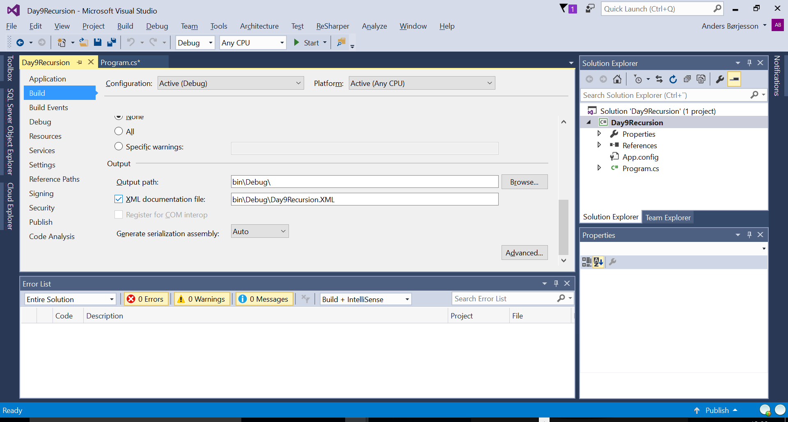
Make Visual Studio use the comments
Visual Studio can show the comments to the programmer using your class, methods, etc.
Visual Studio will generate an XML file from your comments
  This feature must be enabled
    by default is is disabled
  Build the project
    Generates an XML file with comments, etc.
  https://msdn.microsoft.com/en-us/library/x4sa0ak0.aspx

Slide 8
Other special comments: TODO and HACK
Visual Studio recognizes a few other special comments, like
  // TODO some comment
  // HACK some comment
  Note: 2 slashes, not 3 slashes
Theses special comments can be viewed in Visual Studio
  Menu View -> Task List
Used for internal developer comments
Reference
  https://msdn.microsoft.com/en-us/library/zce12xx2(v=vs.110).aspx

Slide 9
Technical writers vs. programmers
Programmers are supposed to writhe the program code and the comments
Programmers are usually better writing code than comments.
Some companies employ technical writers who write program documentation
  Comments in the source code
  Reference documentation
  User manuals
  Tutorials
  etc.

Slide 10
References and further reading
MSDN Recommended Tags for Documentation Comments
  http://msdn.microsoft.com/en-us/library/5ast78ax.aspx

